Slide 1


Faster Hologram Generation and reconstructed image quality enhancement using Distributed Wavefront Recording Planes
MD SIFATUL ISLAM
Masters student, Chungbuk National University
Email : sifatul@osp.chungbuk.ac.kr

Slide 2



Table of contents
Hologram and Wave front Recording Plane
Conventional Multiple Wavefront Recoding Plane (M-WRP) method
Distributed Multiple Wavefront Recoding Plane (DM-WRP) method
Results and Summary
Future work

Slide 3
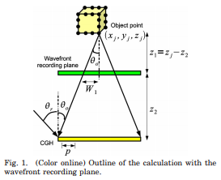
Wavefront recording plane (WRP)
Complex amplitude on a CGH plane as U_{h} ( x, y ) , the object is composed of N points, and the complex amplitude on the CGH created by the i-th point in distance R_{i} is U_{i} ( R_{j} ). The final complex amplitude U_{h} ( x, y ) is expressed by by equation (1)
1
Equation. 1
2
WRP calculates CGH in 2 steps:
The light wave from 3D objects is recorded on a WRP.
Light wave from the WRP to CGH is diffracted calculation based on fast Fourier transform (FFT)
1. Tomoyoshi Shimobaba, Nobuyuki Masuda, and Tomoyoshi Ito, "Simple and fast calculation algorithm for computer-generated hologram with wavefront recording plane," Opt. Lett. 34, 3133-3135 (2009)

Slide 4
Conventional Multiple Wavefront Recording Plane (M-WRP)
Active area size highly influence the calculation time

Slide 5
Conventional Multiple Wavefront Recording Plane (M-WRP)
N(z₁) = 2
N(z₁) = 2
N(z₂) = 1
N(z₂) = 1
N(z₃) = 3
WRP 1
N(z₃) = 3
Depth
Range 1
WRP 1
N(z₄) = 3
N(z₄) = 3
Depth
Range 1
N(z₆) = 1
N(z₆) = 1
N(z₇) = 1
N(z₇) = 1
WRP 2
Depth
Range 2
N(z₆) = 1
N(z₆) = 1
N(z₇) = 2
N(z₇) = 2
Active area size highly influence the calculation time
(a) Number of WRP =1
(b) Number of WRP = 2
**N(Z_{i}) = Number of object point in Z_{i} ^{th} layer
Fig 2 : Depth ranges in conventional M-WRP

Slide 6
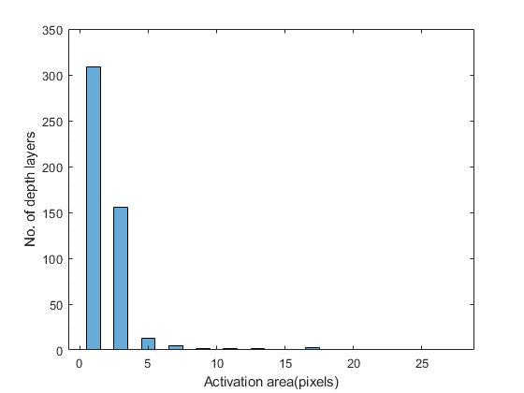
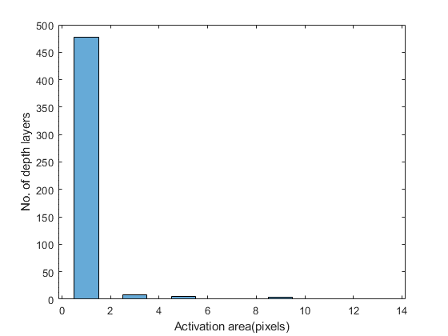
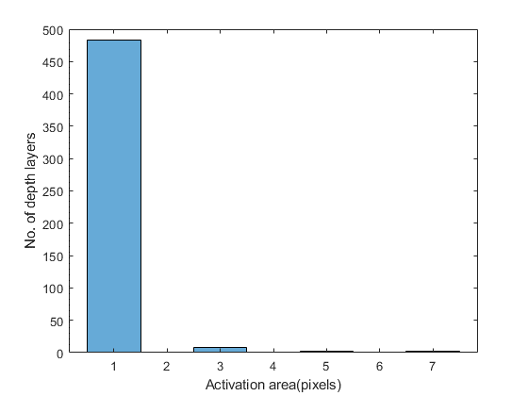
Conventional Multiple Wavefront Recording Plane (M-WRP)
Total number of WRP = 55
PSNR: 11.41
Total number of depth layers
= 55 WRP * 9 depth layers
Total number of WRP = 165
PSNR: 11.88
Total number of depth layers
= 165 WRP * 3 depth layers
Total number of WRP = 248
PSNR : 12.10
Total number of depth layers
= 247 WRP * 2 depth layers + 1 depth layers
Fig 4. Relations among no. of WRP, active area size, and PSNR using Conventional M-WRP method for an object with 495 depth layers
*PSNR : Peak signal-to-noise ratio
*WRP : Wavefront recording plane

Slide 7
Conventional Multiple Wavefront Recording Plane (M-WRP)
Fig 5. Calculation time and PSNR for conventional M-WRP for 248 WRPs

Slide 8
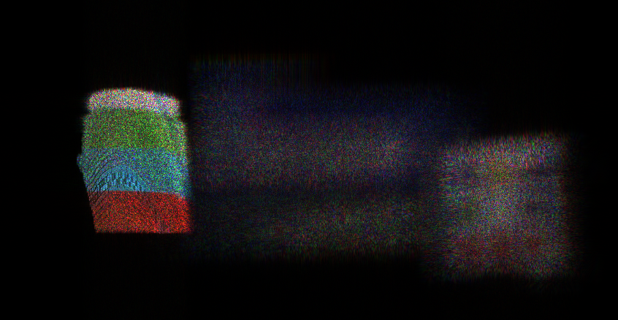
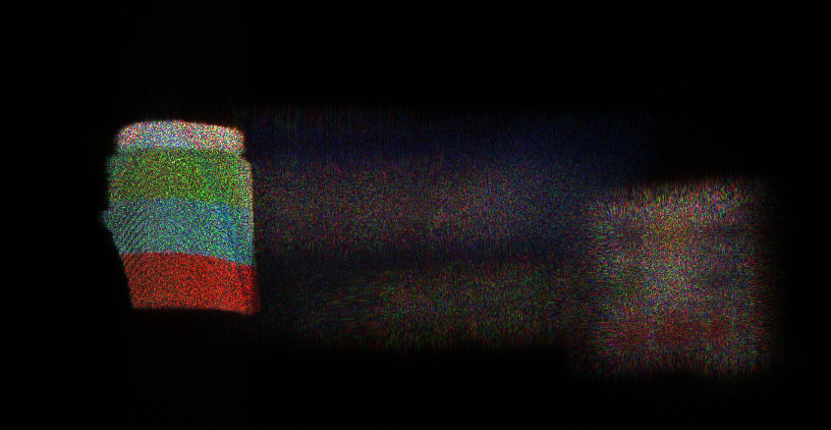
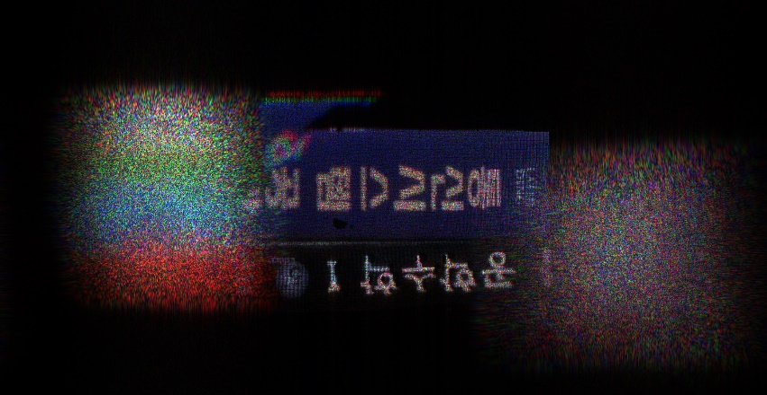
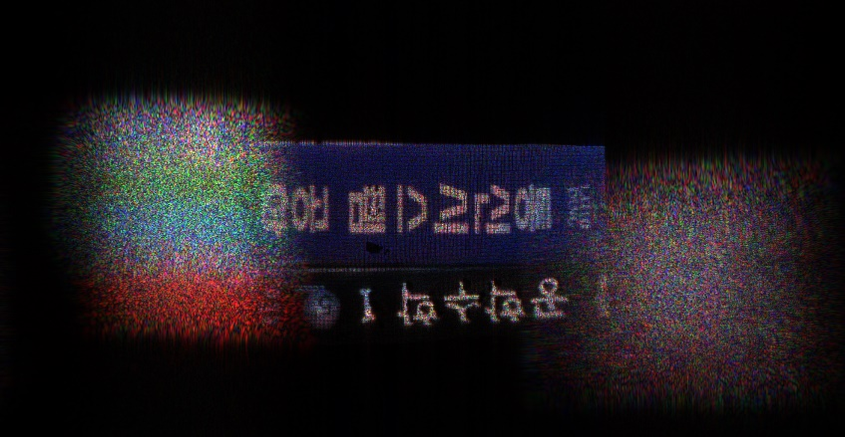
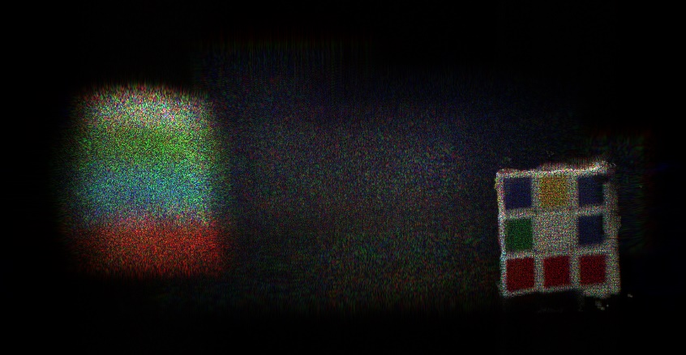
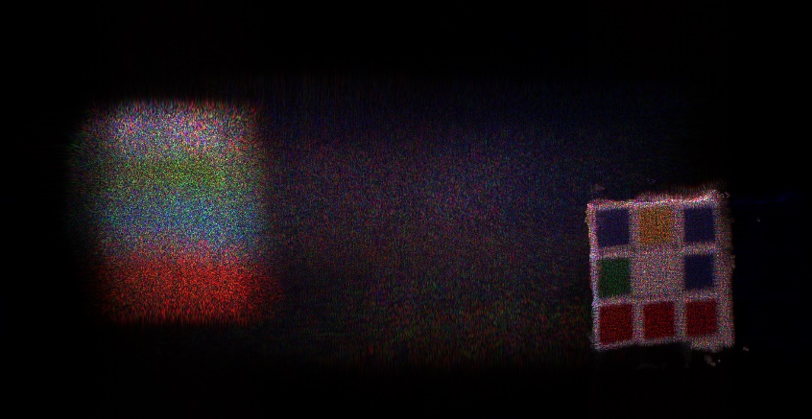
Three items (1980 X1024) |  | Calculation time(sec.)
Conventional Method | 2 WRPs∕color × 3 color | 384.504
 | 4 WRPs∕color × 3 color | 341.539
 | 8 WRPs∕color × 3 color | 346.953
 | 16 WRPs∕color × 3 color | 370.899
 | 32 WRPs∕color × 3 color | 396.148
 | 48 WRPs∕color × 3 color | 418.932
Proposed method | 2 WRPs (Red) 2 WRPS(Green) 4 WRPS (blue) | 298.737
Conventional MWRP
Proposed method
Fig 2 : Depth ranges in conventional M-WRP

Slide 9

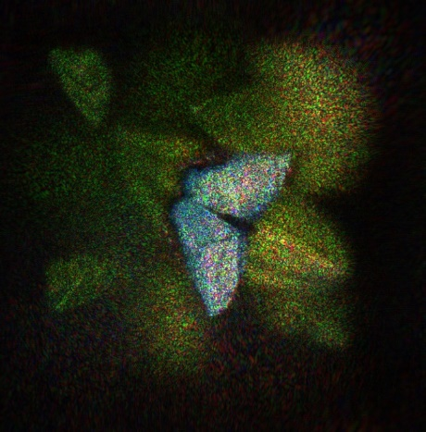
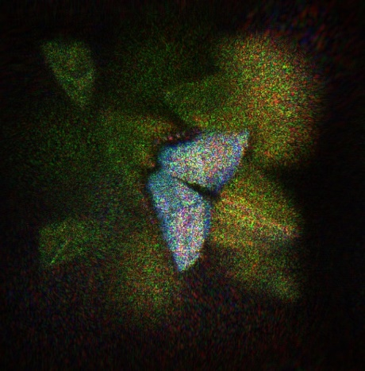





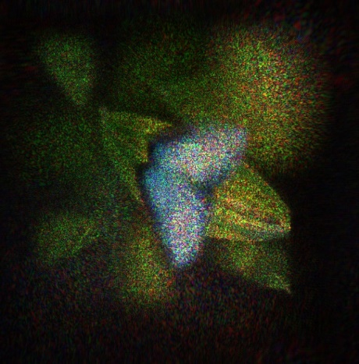
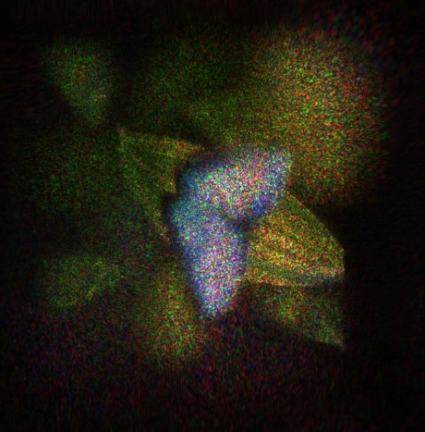


a)
b)
c)
d)
e)
b) Proposed M-WRP
a) Conventional M-WRP
Conventional MWRP
Proposed method
Fig. 5 : Reconstructed image for ‘three object’ using a) conventional M-WRP b) Proposed M-WRP method
Fig 2 : Depth ranges in conventional M-WRP

Slide 10
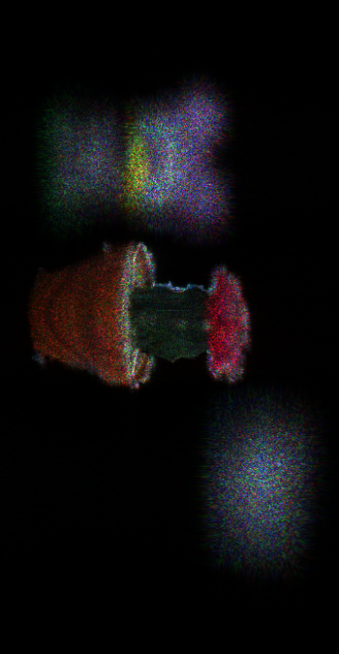
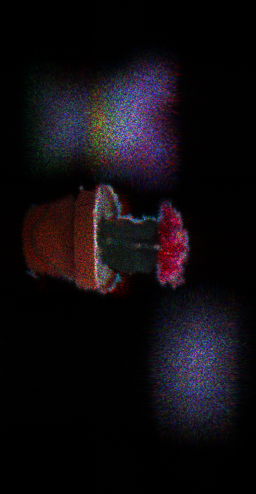
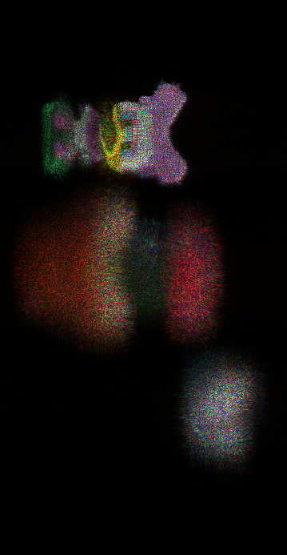
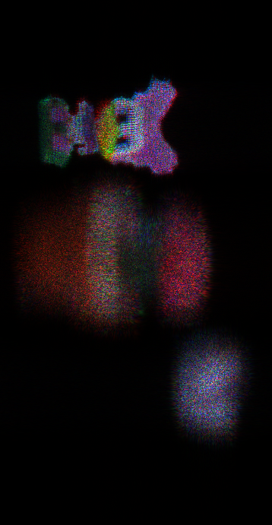
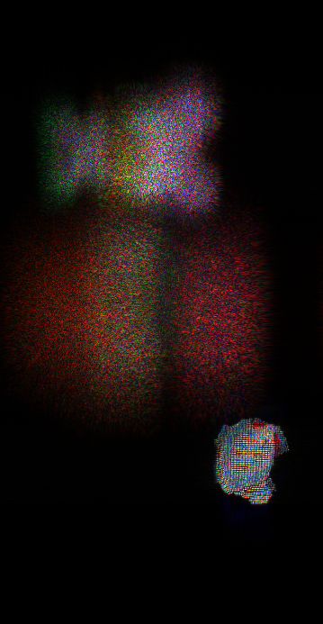
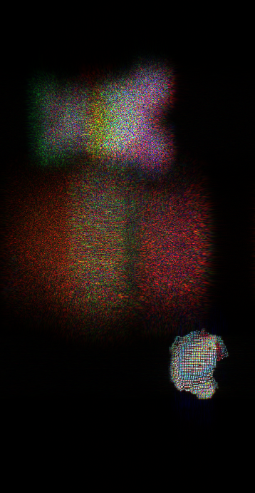
Three objects |  | Calculation time(sec.)
Conventional Method | 2 WRPs∕color × 3 color | 243.406
 | 4 WRPs∕color × 3 color | 242.114
 | 8 WRPs∕color × 3 color | 241.613
 | 16 WRPs∕color × 3 color | 248.276
 | 32 WRPs∕color × 3 color | 254.84
 | 64 WRPs∕color × 3 color | 269.456
Proposed method | 5 WRPs (Red) 5 WRPS(Green) 3 WRPS (blue) | 164.586
a) Conventional M-WRP
b) Proposed M-WRP
Fig. 5 : Reconstructed image for ‘three object’ using a) conventional M-WRP b) Proposed M-WRP method

Slide 11
Three objects |  | Calculation time(sec.)
Conventional Method | 2 WRPs∕color × 3 color | 243.406
 | 4 WRPs∕color × 3 color | 242.114
 | 8 WRPs∕color × 3 color | 241.613
 | 16 WRPs∕color × 3 color | 248.276
 | 32 WRPs∕color × 3 color | 254.84
 | 64 WRPs∕color × 3 color | 269.456
Proposed method | 5 WRPs (Red) 5 WRPS(Green) 3 WRPS (blue) | 164.586
a) Conventional M-WRP
b) MLDR method
Fig. 5 : Reconstructed image for ‘three object’ using a) conventional M-WRP b) Proposed M-WRP method

Slide 12
a) Conventional M-WRP
b) Proposed M-WRP
Fig. 5 : Reconstructed image for ‘three object’ using a) conventional M-WRP b) Proposed M-WRP method

Slide 13




Three objects |  | Calculation time(sec.)
Conventional Method | 2 WRPs∕color × 3 color | 259.42
 | 4 WRPs∕color × 3 color | 183.144
 | 8 WRPs∕color × 3 color | 149.627
 | 16 WRPs∕color × 3 color | 144.432
 | 32 WRPs∕color × 3 color | 144.638
 | 64 WRPs∕color × 3 color | 152.573
 | 128 WRPs∕color × 3 color | 161.668
Proposed method | 16 WRPs (Red) 16 WRPS(Green) 13 WRPS (blue) | 123.437
Conventional MWRP
Proposed method

Slide 14

a) Depth and color image
a) Conventional MWRP
b)Proposed M-WRP method

Slide 15
Results
Object | No. of object point | Resolution | No. of depth layer | Conventional M-WRP |  |  | Proposed DM-WRP
 |  |  |  | No. of WRP | Time(sec.) | PSNR(dB) | No. of WRP | Time(sec.) | PSNR(dB)
Three obj 1 | 84,549 | 190X1024 | 96 | 12 | 341.539 | 17.17 | 9 | 298.737 | 18.11
Three obj 2 | 35,263 | 190X1024 | 128 | 24 | 238.093 | 19.96 | 13 | 164.586 | 20.09
Papilion | 262,098 | 720X720 | 255 | 48 | 144.432 | 17.72 | 45 | 123.437 | 17.72
Table 1 : Calculation time and PSNR comparison between conventional M-WRP and DM-WRP

Slide 16
d
Depth
range 1
d
d
Depth
range 2
d
d
Depth
range 3
d
d
Depth
range 4
d
N(z₁) = 2
d
Depth
range 5
d
N(z₂) = 1
d
Depth
range 6
d
WRP 1
N(z₃) = 3
Depth
Range 1
d
Depth
range 7
d
Depth
range n
N(z₄) = 3
CGH
CGH
N(z₆) = 1
a)
b)
WRP 2
N(z₇) = 1
Depth
Range 2
N(z₆) = 1
N(z₇) = 2
WRP 1

Slide 17
Depth range 1
Depth range 1
Depth range 2
Depth range 3
Depth range 2
Depth range 4
a) Number of WRP = 2
b) Number of WRP = 4
Depth range 1
Depth range 1
L=2
L=4
Depth range 2
L=2
Depth range 3
L=2
Depth range 2
L=4
Depth range 4
L=2
Depth range 3
Depth range 5
c) Number of WRP = 3
d) Number of WRP = 5
Fig. 2. a), b) Depth range distribution in conventional M-WRP method and c), d) proposed M-WRP method

Slide 18
Depth
range 1
Depth
range 1
WRP 1
WRP 1
L
Depth
range 2
WRP 2
Depth
range 2
WRP 2
L
Depth
range 3
L
Depth
range 3
WRP 3
θ
WRP 3
Depth
range 4
θ
θ
WRP 4
L
Depth
range 4
Depth
range 5
WRP 4
WRP 5
WRP
Diffraction
Diffraction
CGH
Diffraction
CGH
CGH
a)
b)
c)
c) Number of WRP = 3
d) Number of WRP = 5
Fig. 2. Schematic diagram of a) Single WRP method proposed in [13] b) conventional M-WRP method c) proposed M-WRP method

Slide 19
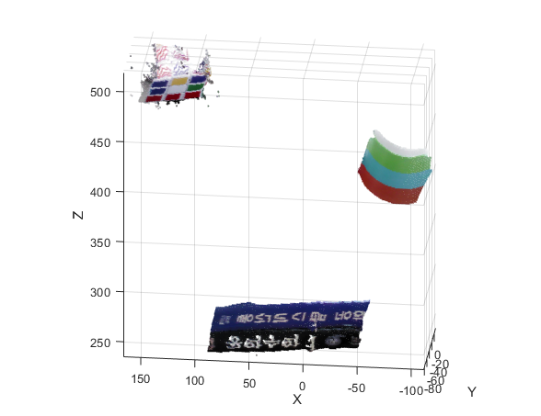
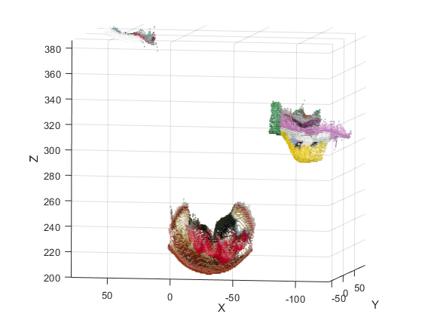
a) Three object 1
b)Three object 2
Fig. 2. Point cloud and position of different objects a) Schematic diagram of a) Single WRP method proposed in [13] b) conventional M-WRP method c) proposed M-WRP method

Slide 20
